Slide 1
Unit VI
(Part I)
Media Access Control
(MAC)
Vinit R Tribhuvan
vrt22.comp@coep.ac.in
1
Notes:
Data Communication

Slide 2
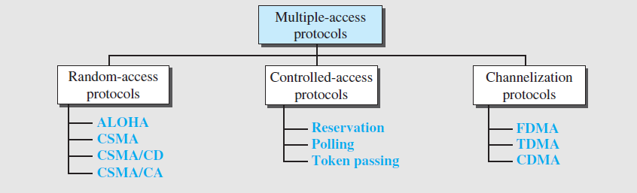
Multiple Access Protocols
2
Notes:
Data Communication

Slide 3
Random Access
Two features –
Random Access - no scheduled time for a station to transmit.
Contention - Stations compete with one another to access the medium.
A station that has data to send uses a procedure defined by the protocol to make a decision on whether or not to send.
Depends on the state of the medium (idle or busy).
3
Notes:
Data Communication

Slide 4
Each station has the right to the medium without being controlled by any other station.
if more than one station tries to send, there is an access conflict—collision
To avoid access conflict or resolve it, each station follows a procedure that answers the following questions:
❑ When can the station access the medium?
❑ What can the station do if the medium is busy?
❑ How can the station determine the success or failure of the transmission?
❑ What can the station do if there is an access conflict?

Slide 5
ALOHA
Developed at the University of Hawaii in early 1970.
It was designed for a radio (wireless) LAN.
The medium is shared between the stations.
When a station sends data, another station may attempt to do so at the same time.
The data from the two stations collide and become garbled.

Slide 6
Pure ALOHA
Original ALOHA
Each station sends a frame whenever it has a frame to send (multiple access).
Since there is only one channel to share, there is the possibility of collision between frames from different stations.

Slide 7
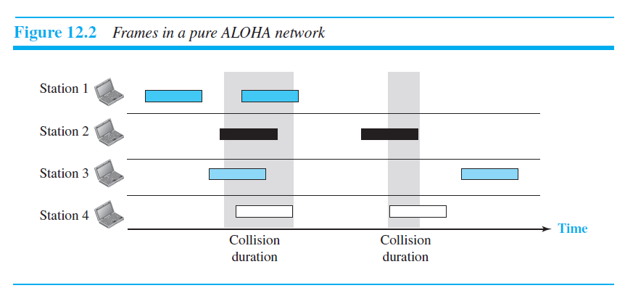
Frames in ALOHA network
Even if one bit of a frame coexists on the channel with one bit from another frame, there is a collision and both will be destroyed.
we need to resend the frames that have been destroyed during transmission.

Slide 8
When a station sends a frame, it expects the receiver to send an acknowledgment.
If the acknowledgment does not arrive after a time-out period, the station assumes that the frame (or the acknowledgment) has been destroyed and resends the frame.

Slide 9
After collision, the stations resend their frames after time-out period.
There is a possibility that the frames may collide again.
In Pure ALOHA, each station waits a random amount of time before resending its frame.
The randomness will help avoid more collisions. And this time is called as the backoff time TB.

Slide 10
backoff time TB
Pure ALOHA has a second method to prevent congesting the channel with retransmitted frames.
After a maximum number of retransmission attempts Kmax, a station must give up and try later.
The time-out period is equal to the maximum possible round-trip propagation delay, which is twice the amount of time required to send a frame between the two most widely separated stations (2 x Tp)
The backoff time TB is a random value that normally depends on K (the number of attempted unsuccessful transmissions).

Slide 11
binary exponential backoff
for each retransmission, a multiplier R = 0 to 2^{K} −1 is randomly chosen and multiplied by Tp (maximum propagation time) or Tfr (the average time required to send out a frame) to find TB.
Note that in this procedure, the range of the random numbers increases after each collision. The value of Kmax is usually chosen as 15.

Slide 12
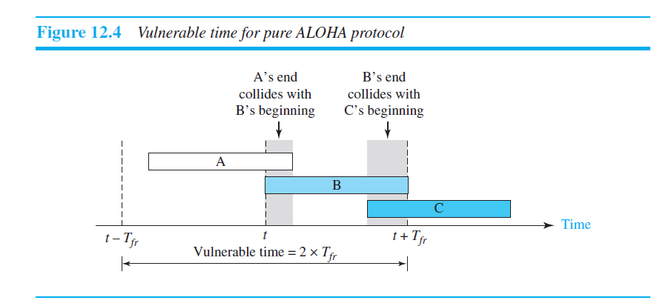
Vulnerable time
It is the length of time in which there is a possibility of collision.

Slide 13
Station B starts to send a frame at time t.
Now imagine station A has started to send its frame after t −Tfr.
This leads to a collision between the frames from station B and station A
suppose that station C starts to send a frame before time t + Tfr.
there is also a collision between frames from station B and station C.

Slide 14

Vulnerable time
we see that the vulnerable time during which a collision may occur in pure ALOHA is 2 times the frame transmission time

Slide 15
Shared ALOHA
there is no rule that defines when the station can send.
A station may send soon after another station has started or just before another station has finished.
Slotted ALOHA improves the efficiency of pure ALOHA.
In slotted ALOHA we divide the time into slots of Tfr seconds and force the station to send only at the beginning of the time slot.

Slide 16
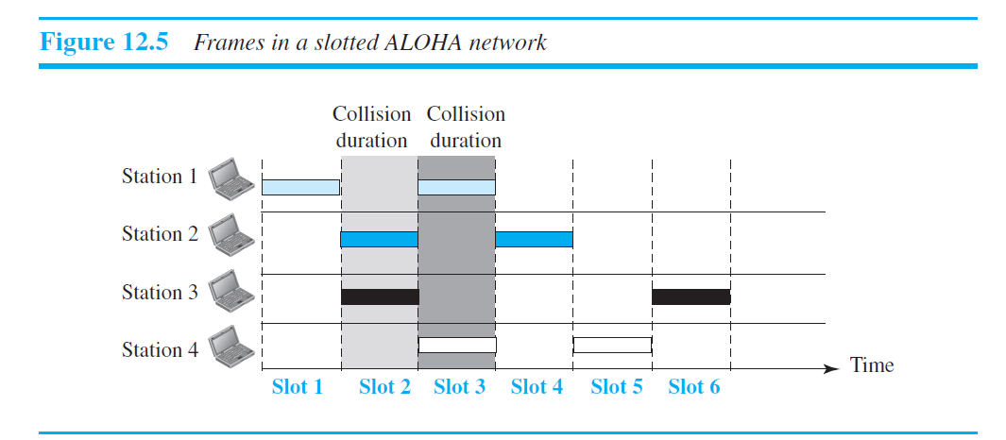

Slide 17

if a station misses this moment, it must wait until the beginning of the next time
slot.
Of course, there is still the possibility of collision if two stations try to send at the beginning of the same time slot.
However, the vulnerable time is now reduced to one-half, equal to Tfr.

Slide 18
Carrier sense multiple access (CSMA)
Minimizes the chance of collision.
each station first listen (sense) to the medium (or check the state of the medium) before sending.
sense before transmit – listen before talk.
CSMA can reduce the possibility of collision, but it cannot eliminate it.

Slide 19
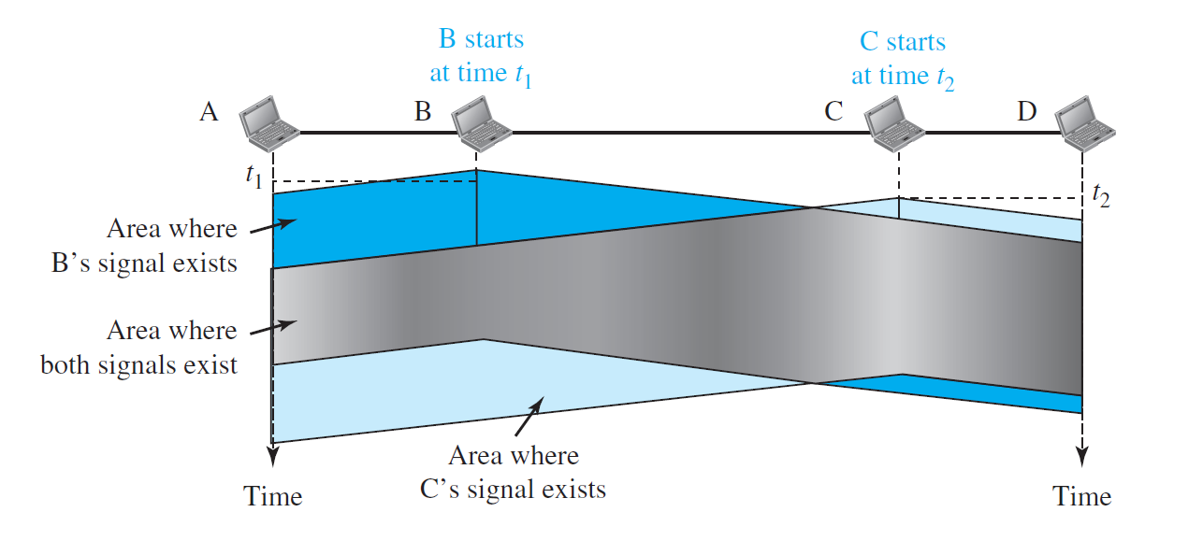
Space/time model of a collision in CSMA

Slide 20
The possibility of collision still exists because of propagation delay.
when a station sends a frame, it still takes time (although very short) for the first bit to reach every station and for every station to sense it.
a station may sense the medium and find it idle, only because the first bit sent by another station has not yet been received.
At time t1, station B senses the medium and finds it idle, so it sends a frame.
At time t2 (t2 > t1), station C senses the medium and finds it idle because, at this time, the first bits from station B have not reached station C.

Slide 21
Station C also sends a frame. The two signals collide and both frames are destroyed.

Slide 22
Vulnerable Time
The vulnerable time for CSMA is the propagation time Tp
This is the time needed for a signal to propagate from one end of the medium to the other.
When a station sends a frame and any other station tries to send a frame during this time, a collision will result.
But if the first bit of the frame reaches the end of the medium, every station will already have heard the bit and will refrain from sending.

Slide 23
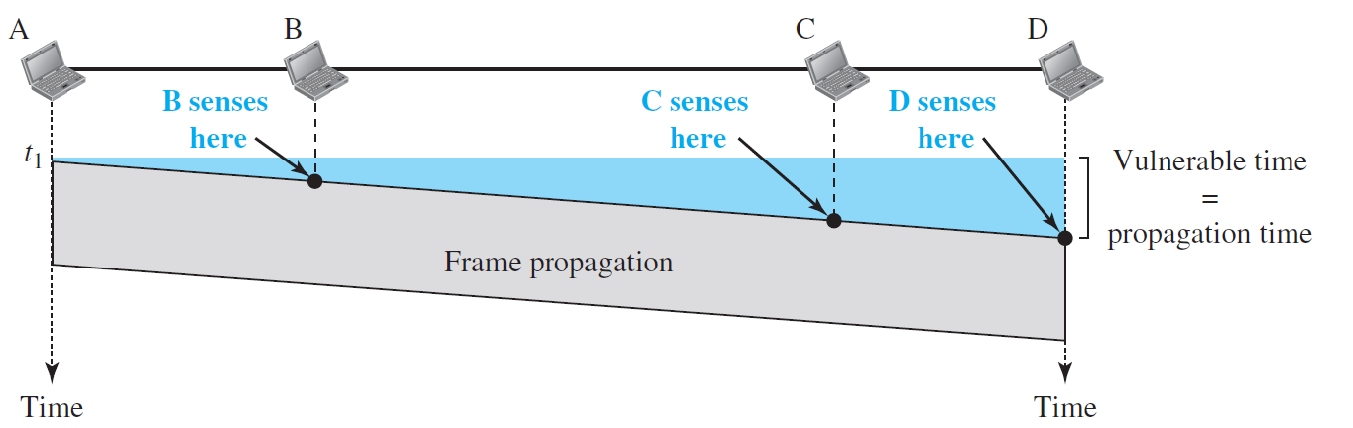
The leftmost station, A, sends a frame at time t1, which reaches the rightmost station, D, at time t1 + Tp. The gray area shows the vulnerable area in time and space.

Slide 24
Questions
What should a station do if the channel is busy?
What should a station do if the channel is idle?

Slide 25
Persistent methods
Three methods
1-persistent method,
nonpersistent method
p-persistent method

Slide 26
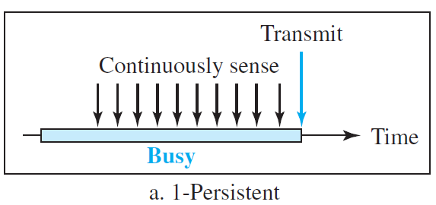
1-persistent method
After the station finds the line idle, it sends its frame immediately (with probability 1).
This method has the highest chance of collision because two or more stations may find the line idle and send their frames immediately.
Ethernet uses this method.

Slide 27
Nonpersistent method
a station that has a frame to send senses the line. If the line is idle, it sends immediately.
If the line is not idle, it waits a random amount of time and then senses the line again.
The nonpersistent approach reduces the chance of collision because it is unlikely that two or more stations will wait the same amount of time and retry to send simultaneously.
reduces the efficiency of the network because the medium remains idle when there may be stations with frames to send.

Slide 28

p-Persistent
used if the channel has time slots with a slot duration equal to or greater than the maximum propagation time.
Combines the advantages of the other two strategies.
It reduces the chance of collision and improves efficiency

Slide 29


p-Persistent
after the station finds the line idle it follows these steps:
With probability p, the station sends its frame.
With probability q = 1 − p, the station waits for the beginning of the next time slot and checks the line again.
a. If the line is idle, it goes to step 1.
b. If the line is busy, it acts as though a collision has occurred and uses the backoff procedure.

Slide 30
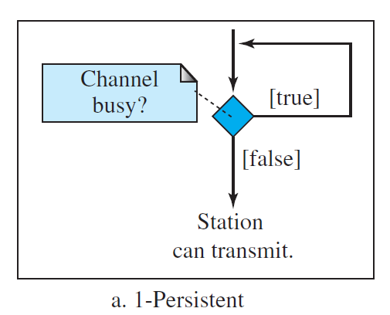

Slide 31
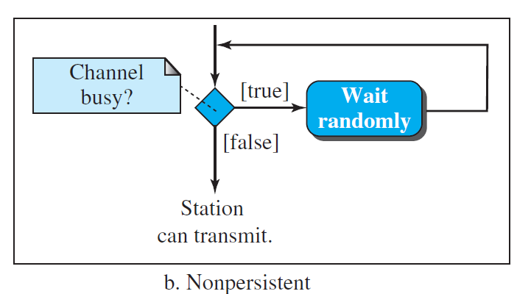

Slide 32
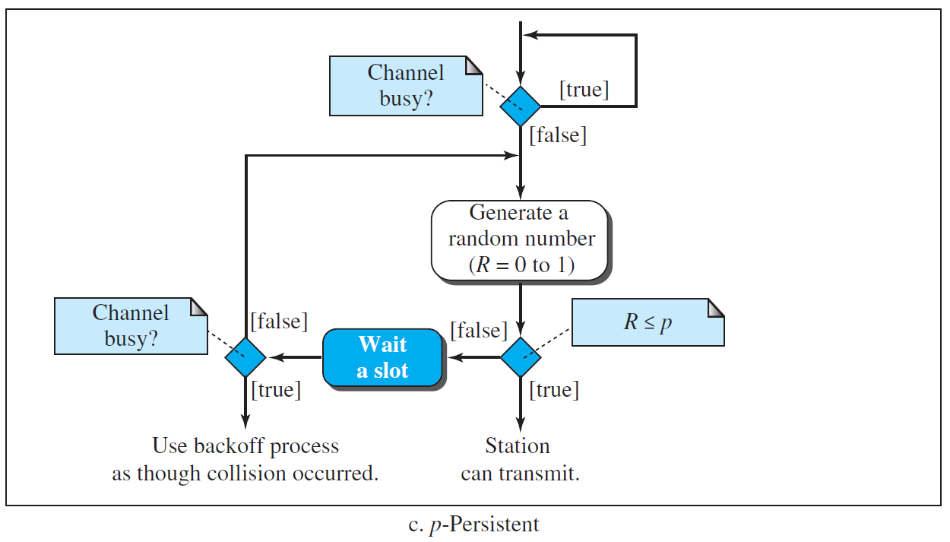

Slide 33
Carrier sense multiple access with collision avoidance (CSMA/CA)
For wireless networks.
Collisions are avoided through the use of CSMA/CA’s three strategies:
the interframe space
the contention window
acknowledgments

Slide 34



Interframe Space (IFS)
collisions are avoided by deferring transmission even if the channel is found idle
When an idle channel is found, the station does not send immediately.
It waits for a period of time called the interframe space or IFS.
a distant station may have already started transmitting
The IFS time allows the front of the transmitted signal by the distant station to
reach this station.
After waiting an IFS time, if the channel is still idle, the station can send, but it still needs to wait a time equal to the contention window

Slide 35



Contention Window
The contention window is an amount of time divided into slots.
The station that is ready to send chooses a random number of slots as its wait time.
The number of slots in the window changes according to the binary exponential backoff strategy.
a random outcome defines the number of slots taken by the waiting station.
the station needs to sense the channel after each time slot.
if the station finds the channel busy, it does not restart the process; it just stops the timer and restarts it when the channel is sensed as idle
Priority to the station with the longest waiting time.

Slide 36
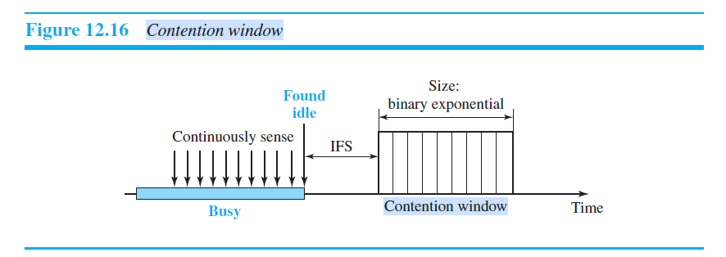

Slide 37
Acknowledgment
There still may be a collision resulting in destroyed data.
However, The positive acknowledgment and the time-out timer can help guarantee that the receiver has received the frame

Slide 38
the exchange of data and control frames in time
1. Before sending a frame, the source station senses the medium by checking the
energy level at the carrier frequency.
a. The channel uses a persistence strategy with backoff until the channel is idle.
b. After the station is found to be idle, the station waits for a period of time called
the DCF interframe space (DIFS); then the station sends a control frame called
the request to send (RTS).

Slide 39
2. After receiving the RTS and waiting a period of time called the short interframe
space (SIFS), the destination station sends a control frame, called the clear to
send (CTS), to the source station. This control frame indicates that the destination
station is ready to receive data

Slide 40
3. The source station sends data after waiting an amount of time equal to SIFS.
4. The destination station, after waiting an amount of time equal to SIFS, sends an
acknowledgment to show that the frame has been received. Acknowledgment is
needed in this protocol because the station does not have any means to check for
the successful arrival of its data at the destination. On the other hand, the lack of
collision in CSMA/CD is a kind of indication to the source that data have
arrived.

Slide 41
how is the collision avoidance aspect of this protocol accomplished?

Slide 42
network allocation vector (NAV)
When a station sends an RTS frame, it includes the duration of time that it needs to occupy the channel.
The stations that are affected by this transmission create a timer called a network allocation vector (NAV) that shows how much time must pass before
these stations are allowed to check the channel for idleness.
Each time a station accesses the system and sends an RTS frame, other stations start their NAV.
In other words, each station, before sensing the physical medium to see if it is idle, first checks its NAV to see if it has expired.

Slide 43
CONTROLLED ACCESS
In controlled access, the stations consult one another to find which station has the right to send.
A station cannot send unless it has been authorized by other stations

Slide 44
Reservation
In the reservation method, a station needs to make a reservation before sending data.
Time is divided into intervals. In each interval, a reservation frame precedes the data frames sent in that interval.
If there are N stations in the system, there are exactly N reservation minislots in the reservation frame.
When a station needs to send a data frame, it makes a reservation in its own minislot.
The stations that have made reservations can send their data frames after the reservation frame

Slide 45
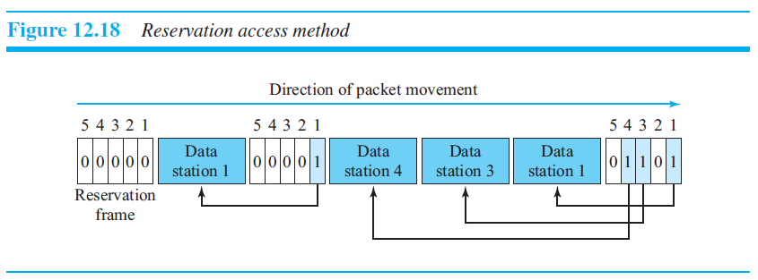

Slide 46
Polling
one device is designated as a primary station and the other devices are secondary station.
All data exchanges must be made through the primary device even when the ultimate destination is a secondary device.
The primary device controls the link; the secondary devices follow its instructions.
Primary device initiates the sessions.
This method uses poll and select functions to prevent collisions.

Slide 47
Select
The select function is used whenever the primary device has something to send.
If the primary is neither sending nor receiving data, it knows the link is available.
If it has something to send, the primary device sends it.
It does not know whether the target device is prepared to receive.
the primary must alert the secondary to the upcoming transmission and wait for an acknowledgment of the secondary’s ready status
Before sending data, the primary creates and transmits a select (SEL) frame, one field of which includes the address of the intended secondary.

Slide 48
Poll
The poll function is used by the primary device to solicit transmissions from the secondary devices.
When the primary is ready to receive data, it must ask (poll) each device in turn if it has anything to send.
When the first secondary is approached, it responds either with a NAK frame if it has nothing to send. It responds with data (in the form of a data frame) if it has data to send.
If the response is negative (a NAK frame), then the primary polls the next secondary in the same manner until it finds one with data to send.
When the response is positive (a data frame), the primary reads the frame and returns an acknowledgment (ACK frame), verifying its receipt.

Slide 49
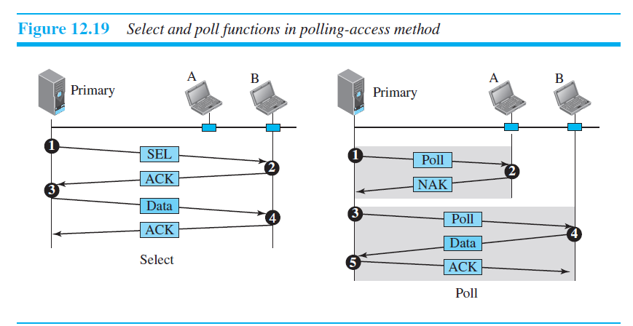

Slide 50
Token Passing
the stations in a network are organized in a logical ring.
for each station, there is a predecessor and a successor.
The current station is the one that is accessing the channel now.
a special packet called a token circulates through the ring.
The possession of the token gives the station the right to access the channel.

Slide 51
When a station has some data to send, it waits until it receives the token from its predecessor.
The station cannot send data until it receives the token again in the next round.
Token management is needed for this access method.
The token must be monitored to ensure it has not been lost or destroyed.
Another function of token management is to assign priorities to the stations and to the types of data being transmitted.
token management is needed to make low-priority stations release the token to high-priority stations.

Slide 52
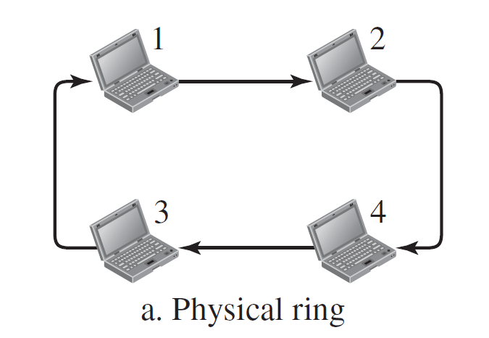
Physical ring
when a station sends the token to its successor, the token cannot be seen by other stations.
the token does not have to have the address of the next successor as token comes next to successor itself.
if one of the links—the medium between two adjacent stations—fails, the whole system fails.

Slide 53
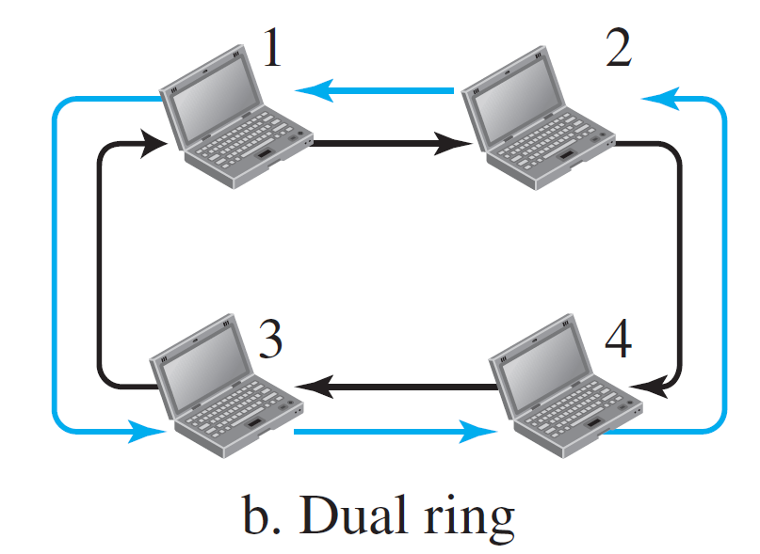
Dual Ring
uses a second (auxiliary) ring which operates in the reverse
direction compared with the main ring.
The second ring is for emergencies only.
If one of the links in the main ring fails, the system automatically combines the two rings to form a temporary ring.
for this topology to work, each station needs to have two transmitter ports and two receiver ports

Slide 54
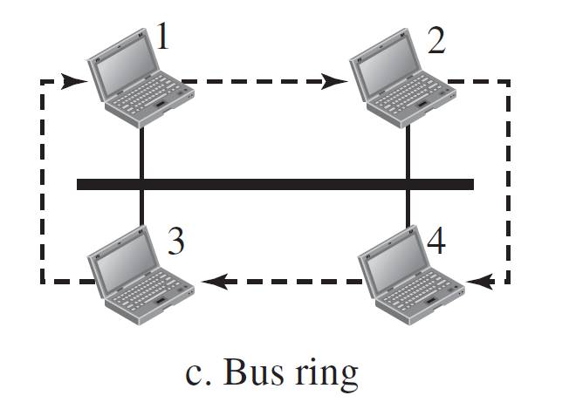
Bus-Ring
also called a token bus.
The bus, makes a logical ring, because each station knows the address of its successor.
When a station has finished sending its data, it releases the token and inserts the address of its successor in the token which gets access to the token.

Slide 55
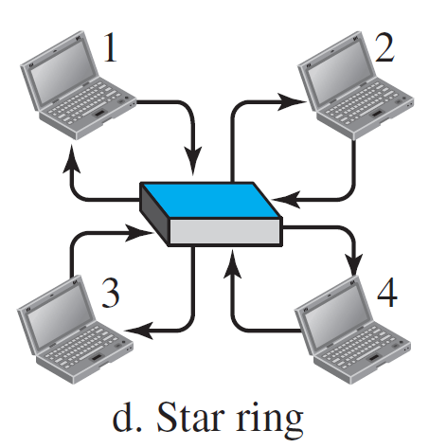
Star Ring
the physical topology is a star.
There is a hub which acts as a connector.
The wiring inside the hub makes the ring; the stations are connected to this ring through the two wire connections.
less prone to failure because if a link goes down, it will be bypassed by the hub and the rest of the stations can operate.
adding and removing stations from the ring is easier.

Slide 56
CHANNELIZATION
Channelization (or channel partition, as it is sometimes called) is a multiple-access method in which the available bandwidth of a link is shared in time, frequency, or through code, among different stations

Slide 57
Frequency-division multiple access (FDMA)
In frequency-division multiple access (FDMA), the available bandwidth is divided into frequency bands
Each station is allocated a band to send its data.
each band is reserved for a specific station
Each station also uses a bandpass filter to confine the transmitter frequencies.

Slide 58
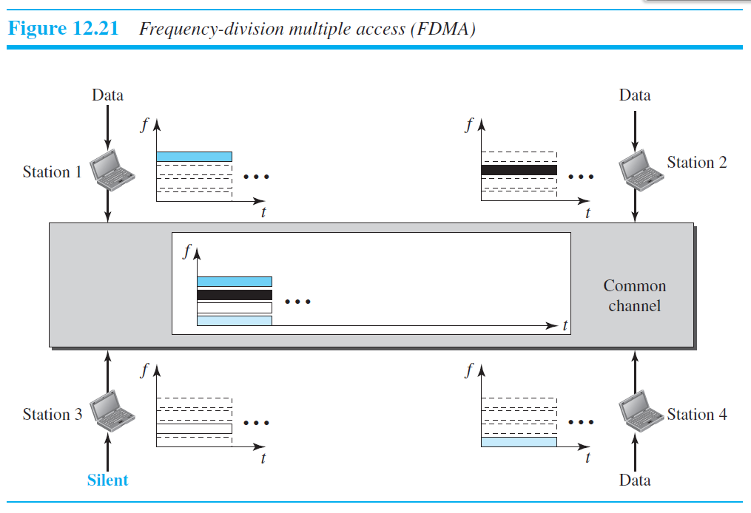

Slide 59
FDMA specifies a predetermined frequency band for the entire period of communication.
FDMA, on the other hand, is an access method in the data-link layer.
There is no physical multiplexer at the physical layer as in FDM

Slide 60


Time-division multiple access (TDMA)
The stations share the bandwidth of the channel in time.
Each station is allocated a time slot during which it can send data.
Each station transmits its data in its assigned time slot.
Each station needs to know the beginning of its slot and the location of its slot.
To compensate for the delays, we can insert guard times.
Synchronization is normally accomplished by having some synchronization bits.

Slide 61
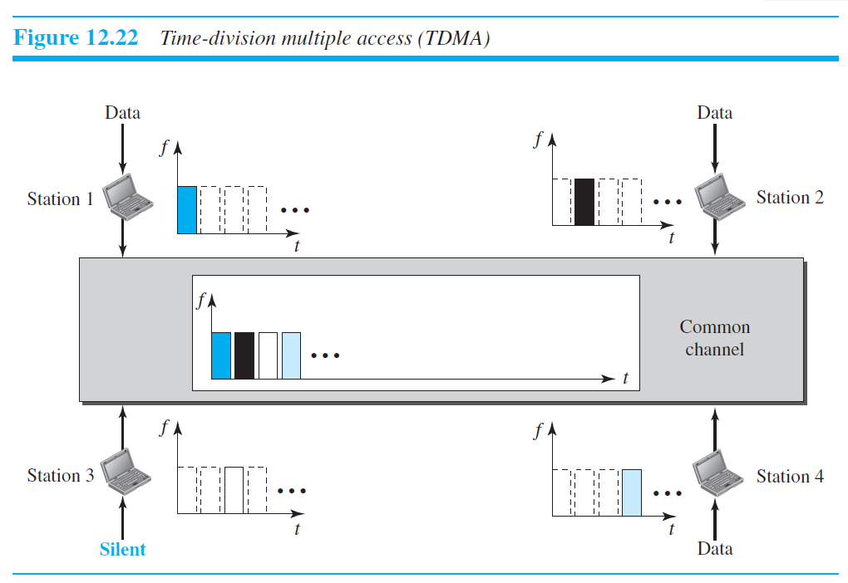

Slide 62
Code-division multiple access (CDMA)
CDMA differs from FDMA in that only one channel occupies the entire bandwidth of the link.
It differs from TDMA in that all stations can send data simultaneously.
CDMA simply means communication with different codes.
CDMA is based on coding theory.
Each station is assigned a code, which is a sequence of numbers called chips.

Slide 63
They are called orthogonal sequences and have the following properties:
1. Each sequence is made of N elements, where N is the number of stations.
2. If we multiply a sequence by a number, every element in the sequence is multiplied
by that element. This is called multiplication of a sequence by a scalar.
3. If we multiply two equal sequences, element by element, and add the results, we
get N, where N is the number of elements in each sequence. This is called the inner
product of two equal sequences.
4. If we multiply two different sequences, element by element, and add the results,
we get 0. This is called the inner product of two different sequences

Slide 64
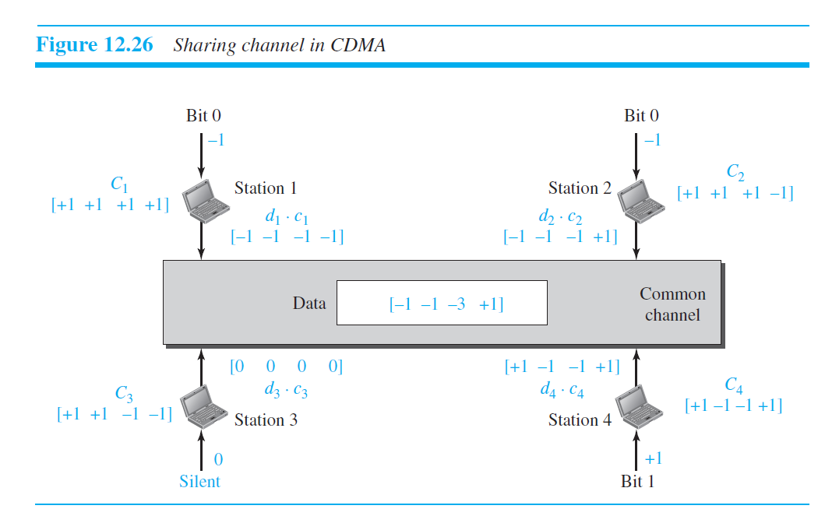

Slide 65
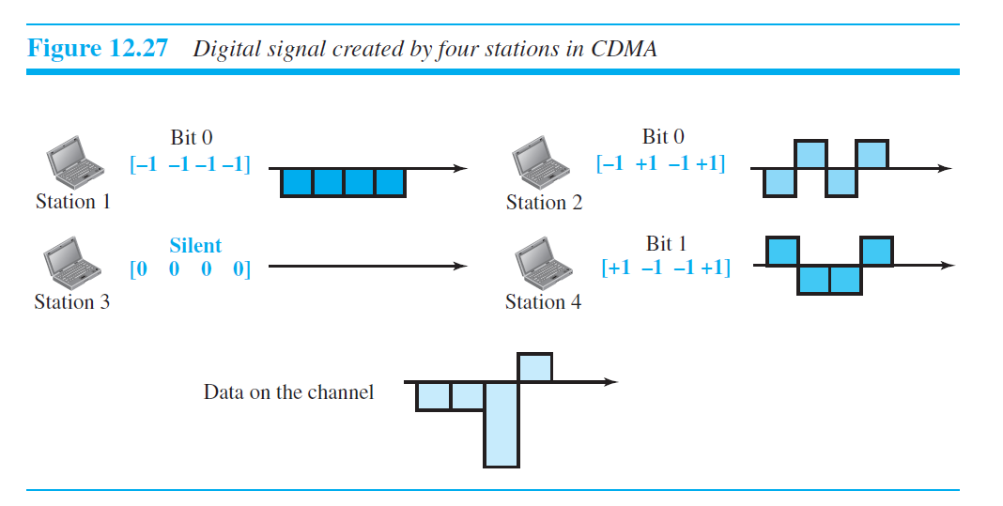

Slide 66
Walsh Tables
To generate chip sequences.
is a two-dimensional table with an equal number of rows and columns
each row is a sequence of chips
W1 for a one-chip sequence has one row and one column. (choose −1 or +1)
if we know the table for N sequences WN, we can create the table for 2N sequences W2N

Slide 67
W2 can be made from four W1s
W4 can be made of four W2s, with the last one the complement of W2
W8 is composed of four W4s

Slide 68
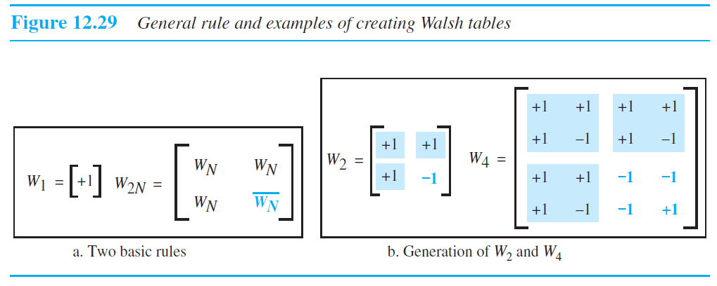

Slide 69
the number of sequences, N, needs to be a power of 2.

